Slide 1

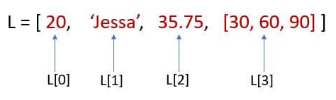
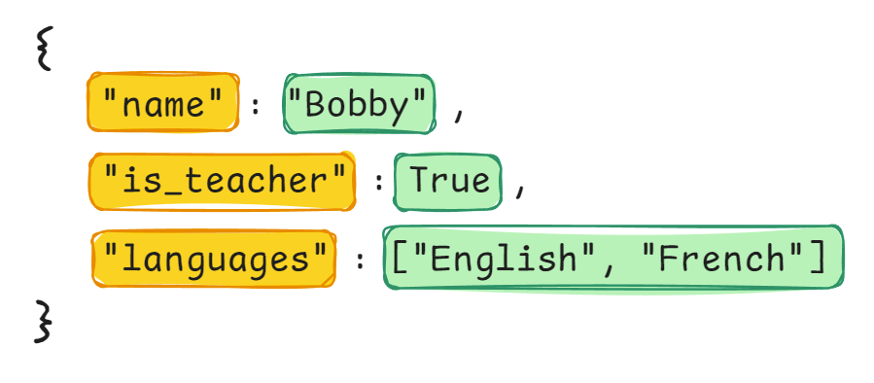
Week 4: Lists and Dictionaries
Lists are collections of individual items
Dictionaries are collections of key-value entries
The list `L` has 4 items.
This dictionary has 3 entries.

Slide 2
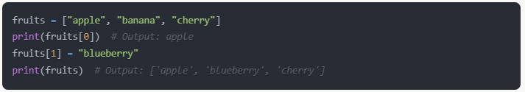
Creating an Accessing Lists
Assign the list to a variable called `fruits`
Square brackets create a new list.
“A list of strings”
Lists are a collection of items (or “elements” if you prefer).
The order of the items is maintained: item0 → item1 → item2 → etc.
Use square brackets [ ] to create new lists.
Access elements by index (starting from 0).

Slide 3
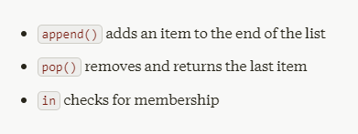
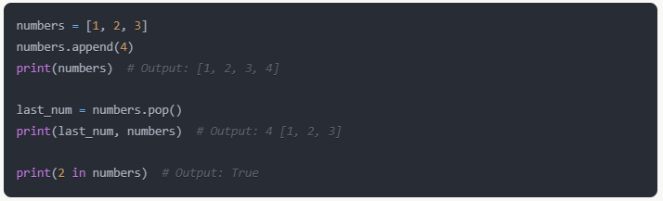


Essential List Methods / Operations
This expression involving `in` resolves to a Boolean!
We can “capture” the element that was “popped off” the list if we need it for something...
In this example, we store it in the variable `last_num`.

Slide 4
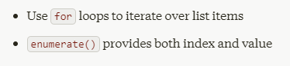
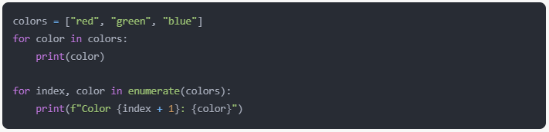
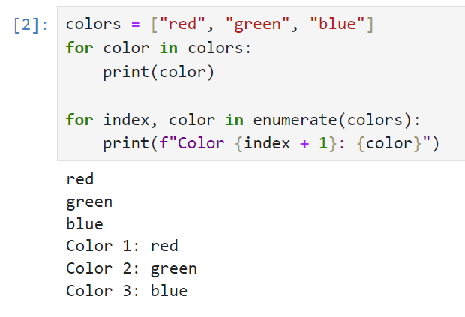
Looping Through Lists
The built-in `enumerate()` function can come in handy when we want the index number too!
index, color are both “unpacked” from the enumerate() method.

Slide 5
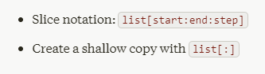
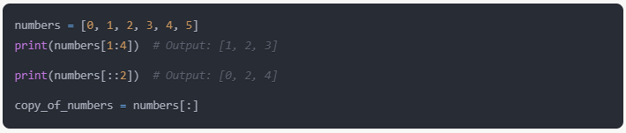


Slicing and Copying Lists
Defaults to the length of the list
Defaults to 0
Try it in Jupyter!!!
Defaults to 1
When using the slicing [:] syntax, if you don’t specify one of then arguments, then it will use the default values. For example:
numbers[ : ] is the same thing as numbers[0 : len(numbers) : 1]
Sometimes you want to copy a list (i.e. duplicate the data in the RAM) Well, slicing does that for you! The expression numbers[:] copies the list!

Slide 6
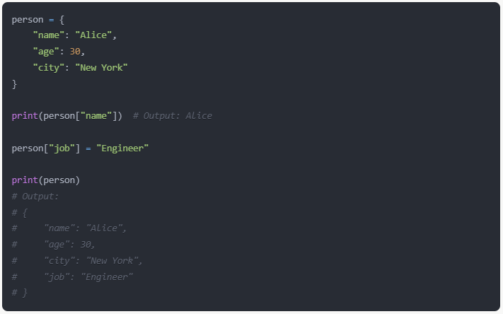
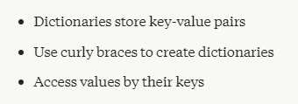

Creating and Accessing Dictionaries

Slide 7
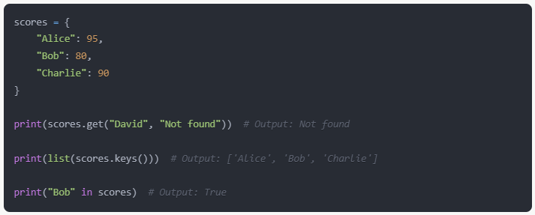
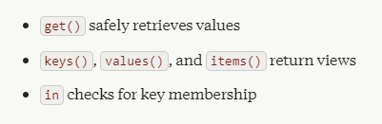
Essential Dictionary Methods
keys() , values() , and items() let us view dictionary data.
Call list() if you want to make a copy of the data into a new list.

Slide 8
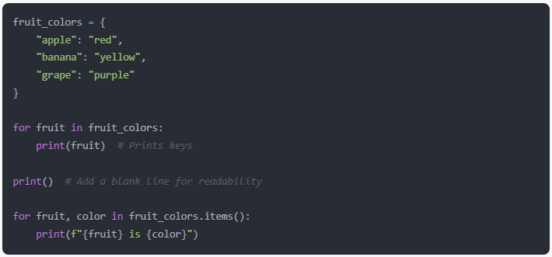
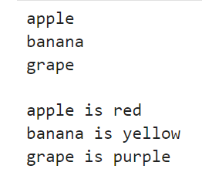
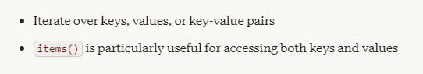

Looping Through Dictionaries
fruit, color are both “unpacked” from the items() method.

Slide 9
